Slide 1

Amazon Elastic Compute Cloud (EC2)
Unlimited Powerful Learning
• EC2 = Elastic Compute Cloud = Infrastructure as a Service(IaaS)
• Amazon EC2 provides on-demand , scalable computing capacity in the Amazon Web Services (AWS) Cloud. Using Amazon EC2 reduces hardware costs so you can develop and deploy applications faster.
• It mainly consists in the capability of :
- Renting virtual machines (EC2)
- Storing data on virtual drives (EBS)
- Distributing load across machines (ELB)
- Scaling the services using an auto-scaling group (ASG)

Slide 2
Features of Amazon EC2
Unlimited Powerful Learning
Amazon EC2 provides the following high-level features:
Instances: Virtual servers.
Amazon Machine Images (AMIs):Preconfigured templates for your instances that package the components you need for your server (including the operating system and additional software).
Instance types : Various configurations of CPU, memory, storage, networking capacity, and graphics hardware for your instances.
Key pairs : Secure login information for your instances. AWS stores the public key and you store the private key in a secure place.
Instance store volumes : Storage volumes for temporary data that is deleted when you stop, hibernate, or terminate your instance.
Amazon EBS volumes : Persistent storage volumes for your data using Amazon Elastic Block Store (Amazon EBS).Regions, Availability Zones, Local Zones, AWS Outposts, and Wavelength Zones. Multiple physical locations for your resources, such as instances and Amazon EBS volumes.
Security groups: A virtual firewall that allows you to specify the protocols, ports, and source IP ranges that can reach your instances, and the destination IP ranges to which your instances can connect.
Elastic IP addresses: Static IPv4 addresses for dynamic cloud computing.
Tags : Metadata that you can create and assign to your Amazon EC2 resources.
Virtual private clouds (VPCs) : Virtual networks you can create that are logically isolated from the rest of the AWS Cloud. You can optionally connect these virtual networks to your own network.

Slide 3
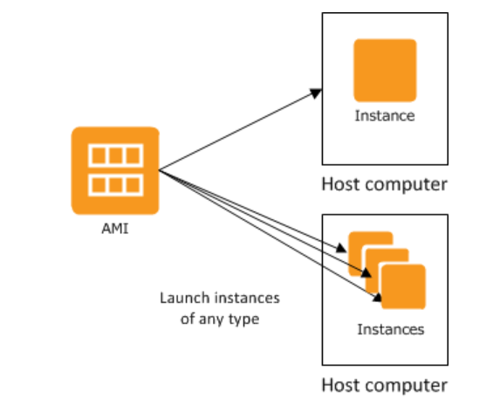
Instances and AMIs
Unlimited Powerful Learning
An Amazon Machine Image (AMI) is a template that contains a software configuration (for example, an operating system, an application server, and applications). From an AMI, you launch an instance, which is a copy of the AMI running as a virtual server in the cloud. You can launch multiple instances of an AMI, as shown in the following figure.
Your instances keep running until you stop, hibernate, or terminate them, or until they fail. If an instance fails, you can launch a new one from the AMI.

Slide 4
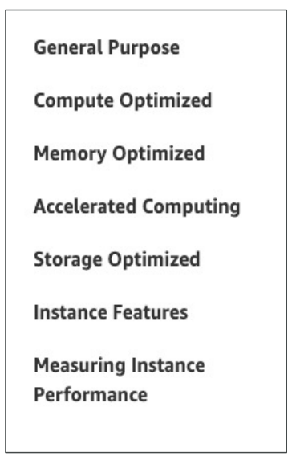
Instance Types
Unlimited Powerful Learning
When you launch an instance, the instance type that you specify determines the hardware of the host computer used for your instance. Each instance type offers different compute, memory, and storage capabilities, and is grouped in an instance family based on these capabilities.
Select an instance type based on the requirements of the application or software that you plan to run on your instance.
AWS has the following naming convention:
m5.2xlarge
- m: instance class
- 5: generation (AWS improves them over time)
- 2xlarge: size within the instance class

Slide 5
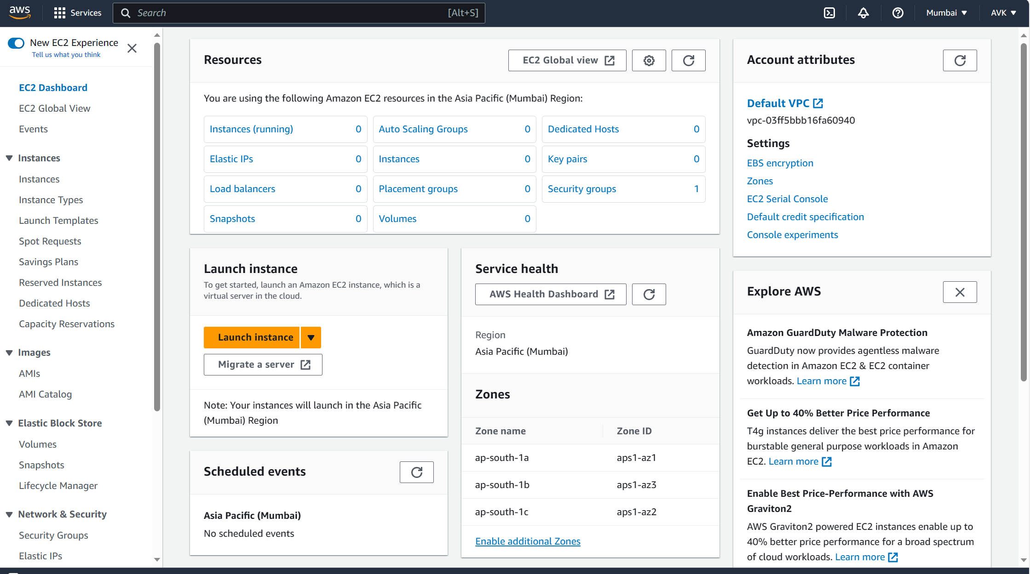
Launching & Configuring EC2
Unlimited Powerful Learning
Step1:
Login in to your AWS management console website.
Select EC2 service and click on Launch instance tab.

Slide 6
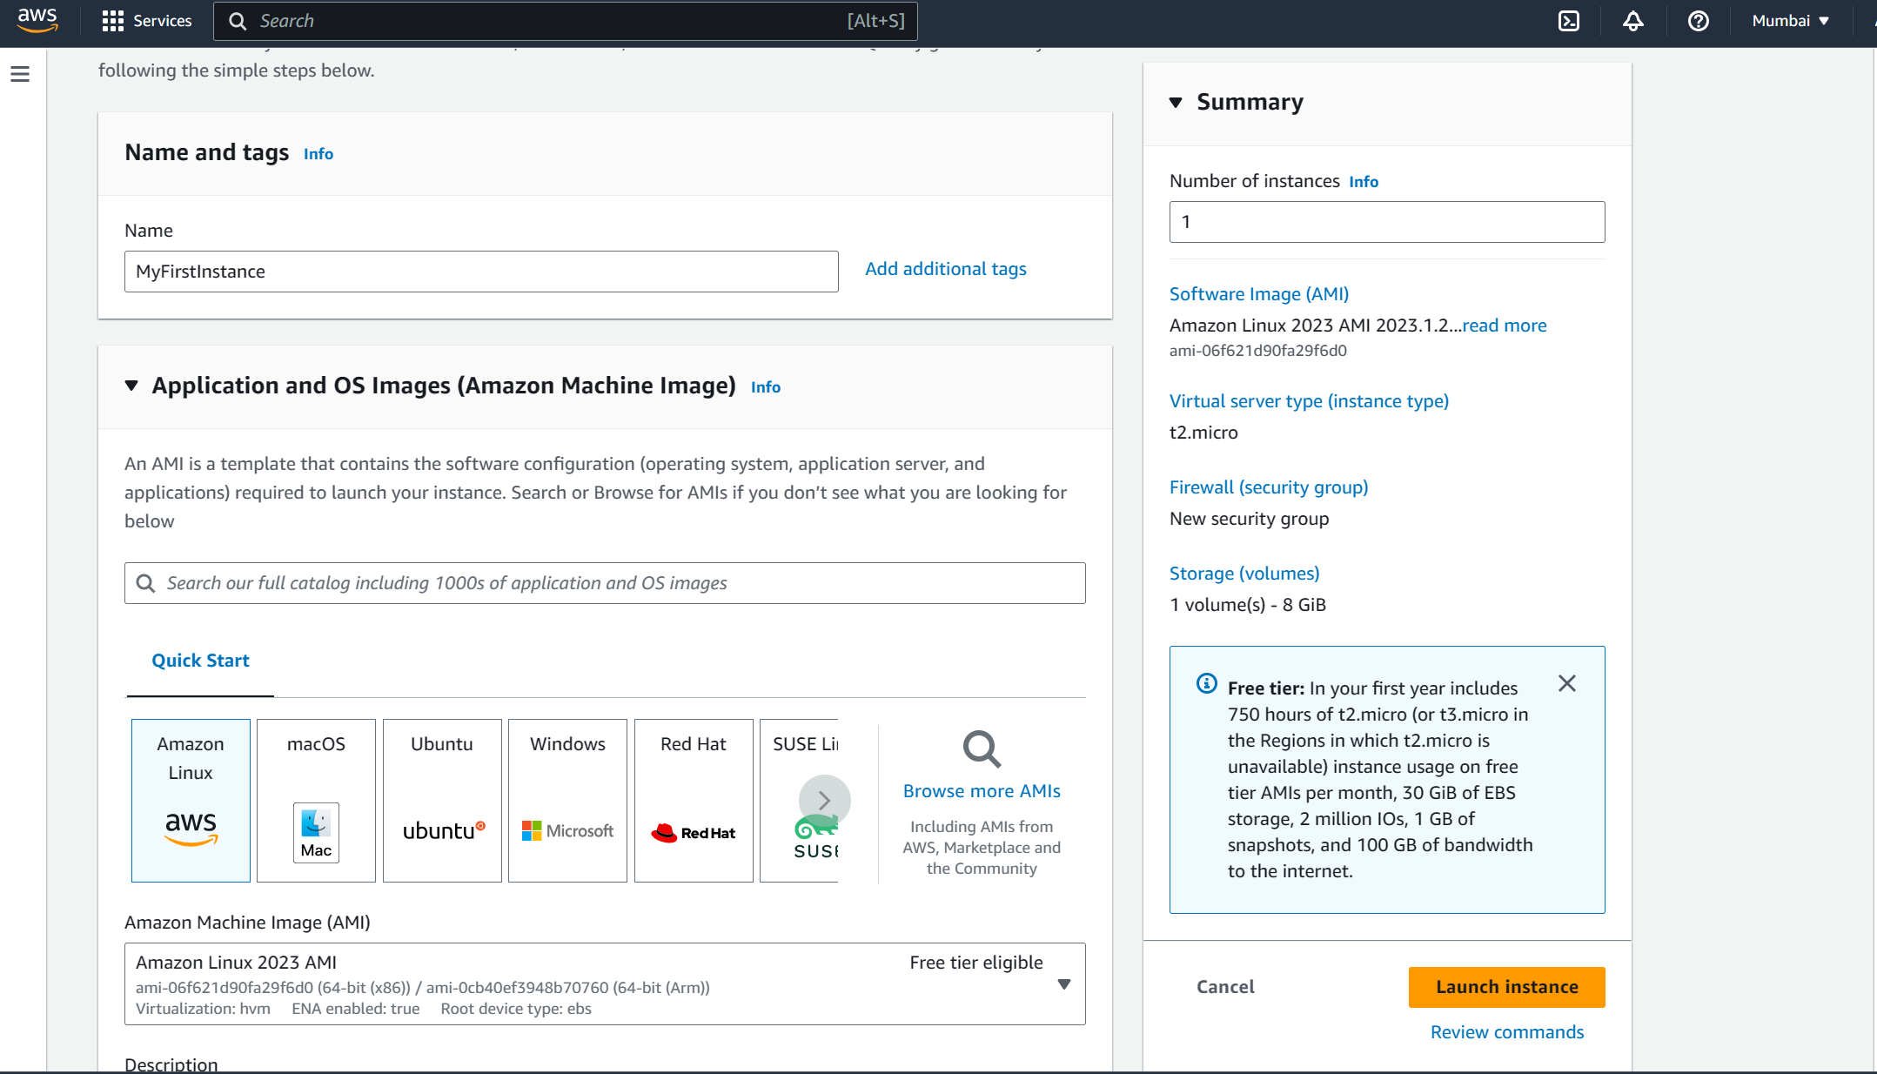
Unlimited Powerful Learning
Step2:
In Name and tags type a instance name as MyFirstInstance.
In Number of instances type as 1. with the help of this tab we can launch as many instances as we want with a same configuration.
In Application and OS Images(Amazon Machine Image) select OS as Amazon Linux.
In Amazon Machine Image (AMI)select default Amazon Linux 2023 AMI configuration as it is a Free tier eligible configuration.

Slide 7
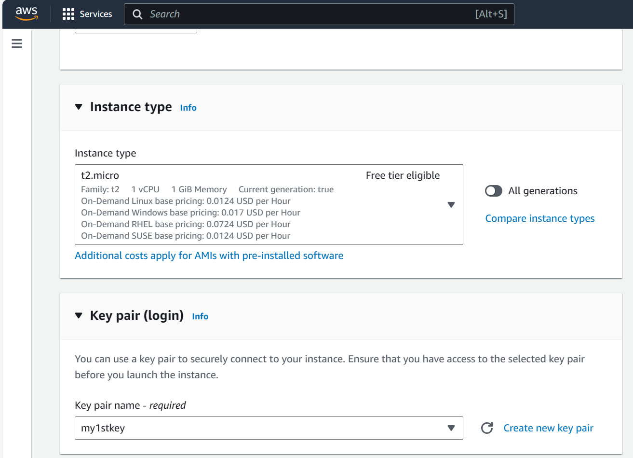
Unlimited Powerful Learning
Step3:
In a Instance type tab we can select configuration as per our application and configuration. For this instance we will select t2.micro and it is Free tier eligible.
We use a key pair to securely connect to our Instance. Create a new key pair and select it.

Slide 8
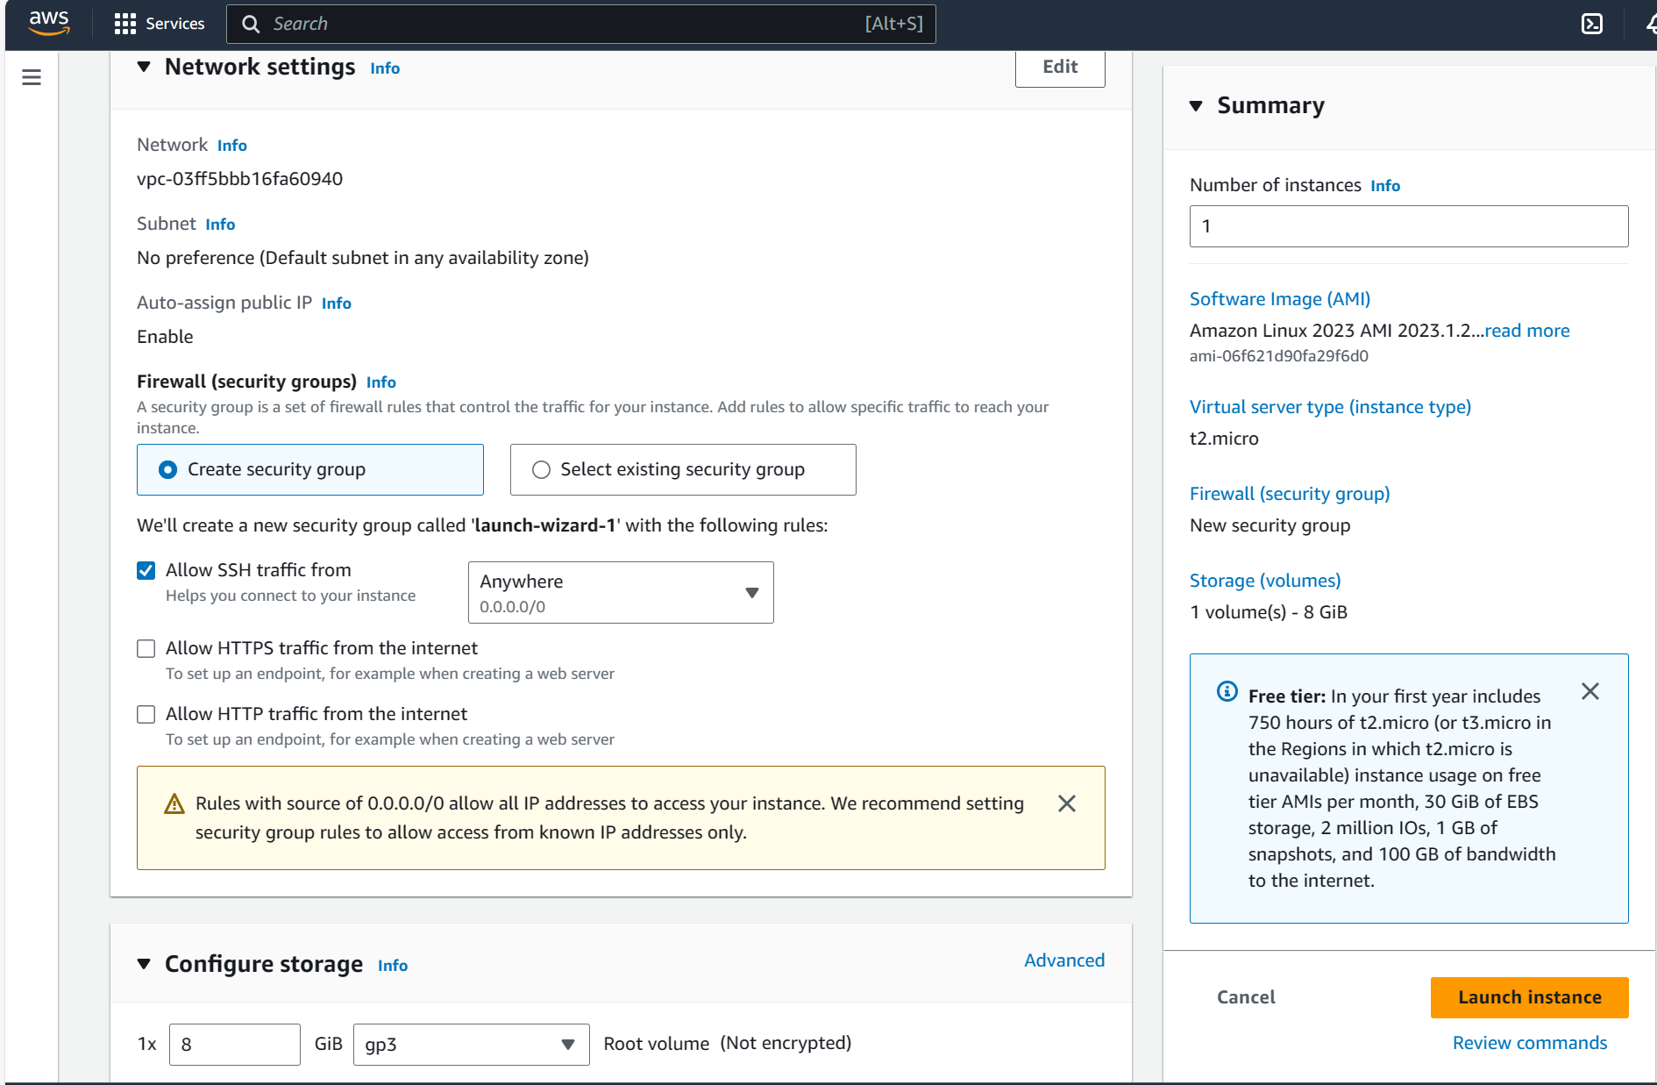
Unlimited Powerful Learning
Step4:
In Network setting create a Firewall (Security group) as Allow SSH traffic from Anywhere.
For Configure Storage tab select default 8GiB root Volume.
Click on Launch Instance tab.

Slide 9
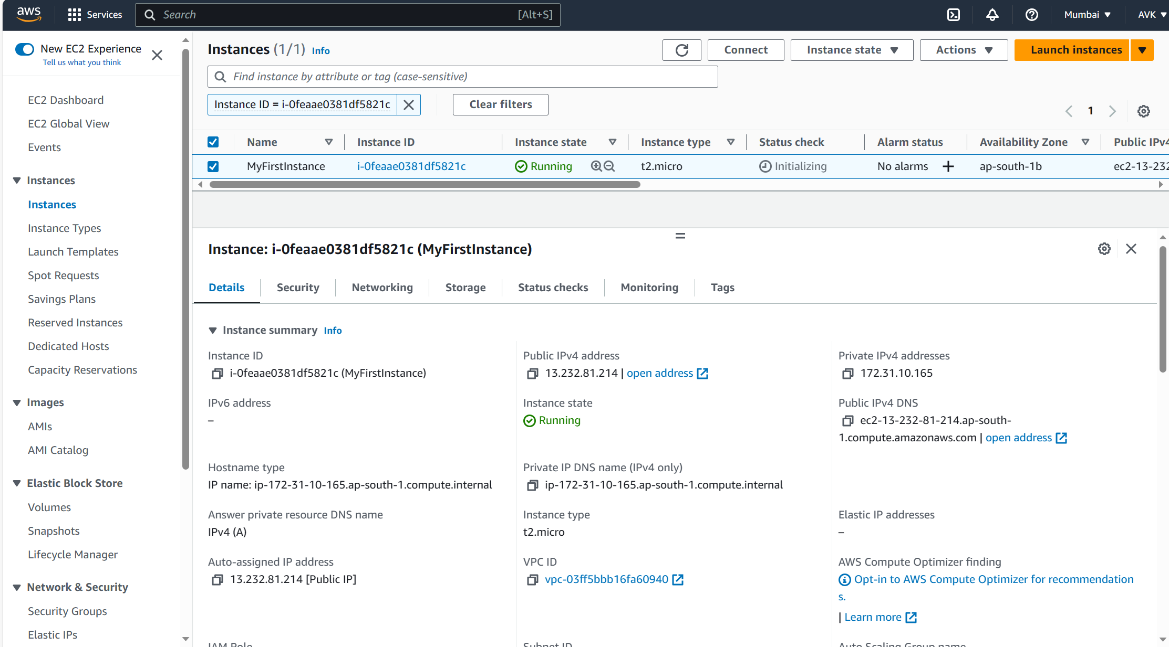
Unlimited Powerful Learning
Step5:
Now we can see our instance named MyFirstInstance is launched successfully and Instance State is showing as running.

Slide 10
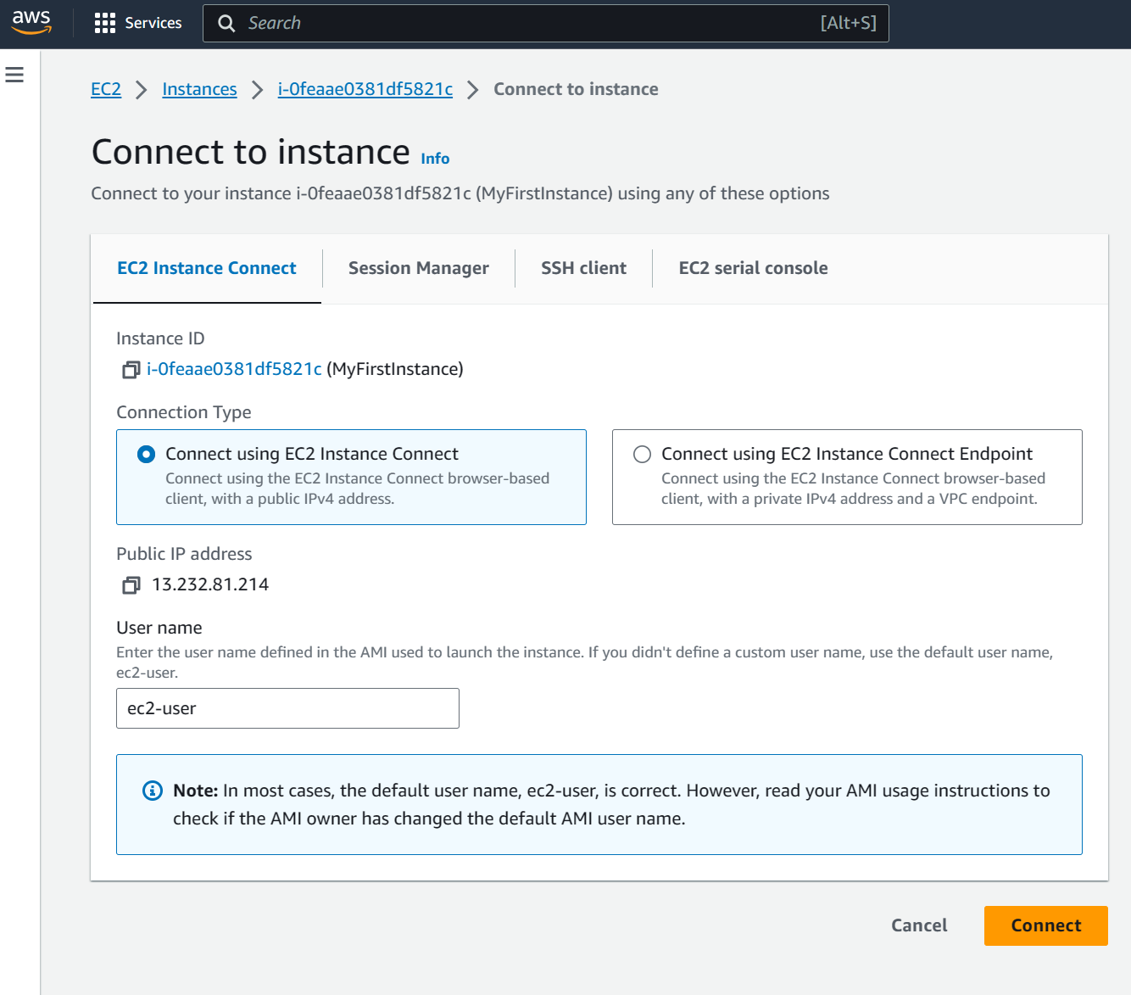
Unlimited Powerful Learning
Step6 :
Click on Connect button and select as Connect using EC2 Instance Connect and again click on Connect button.

Slide 11
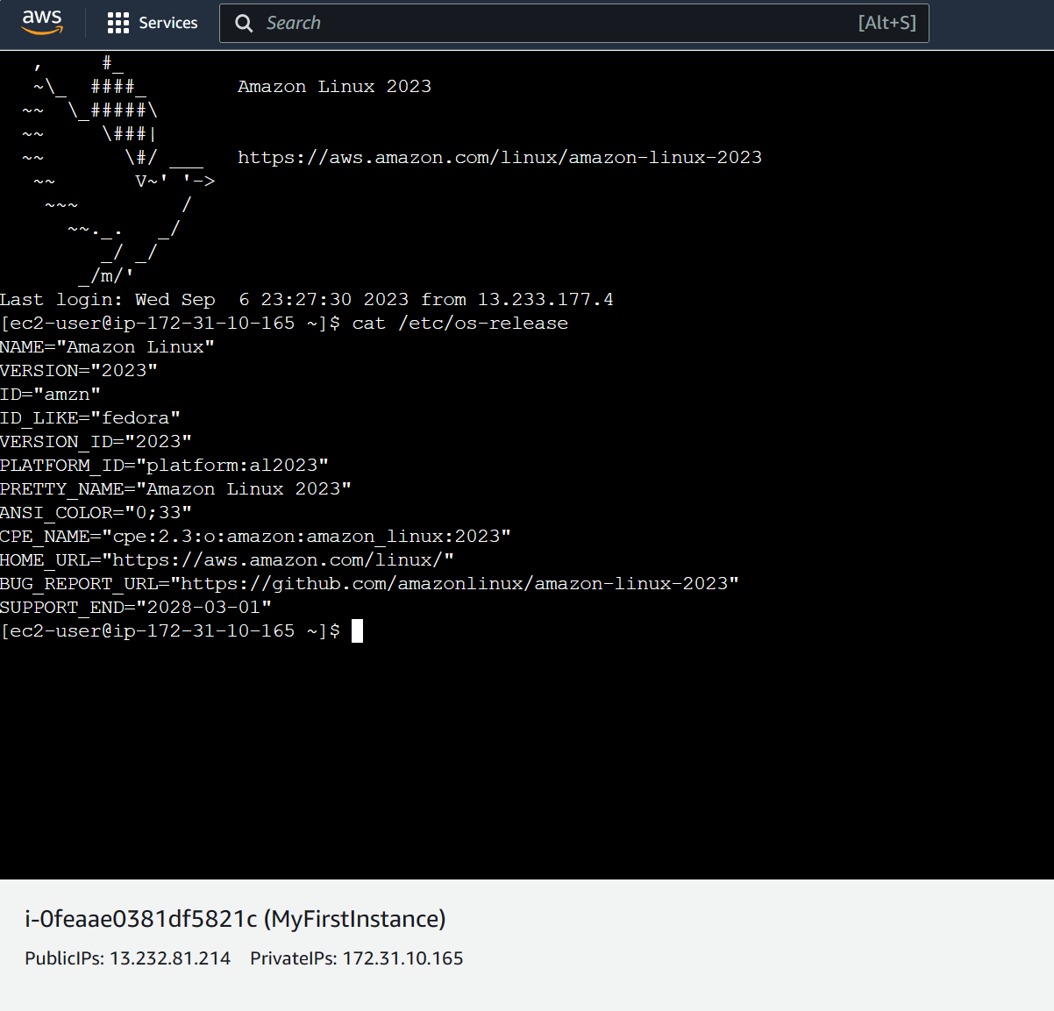
Unlimited Powerful Learning
Step7 :
As We can see now we have connected with our Amazon EC2 instance successfully.
Type command as cat /etc/os-release to check OS version details.

Slide 12
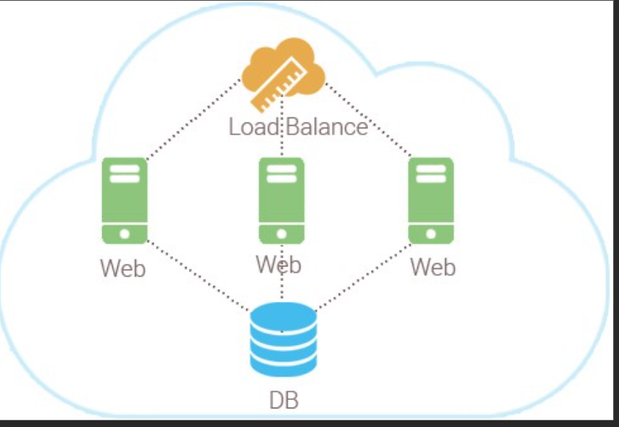
Load balancing & Auto Scaling
Unlimited Powerful Learning
Load Balancing:
A load balancer distributes workloads across multiple compute resources, such as virtual servers. Using a load balancer increases the availability and fault tolerance of your applications.
You can add and remove compute resources from your load balancer as your needs change, without disrupting the overall flow of requests to your applications.
You can configure health checks, which monitor the health of the compute resources, so that the load balancer sends requests only to the healthy ones. You can also offload the work of encryption and decryption to your load balancer so that your compute resources can focus on their main work.
Three types of Load balancing are available:
Network Load balancing
Application Load balancing
Gateway Load balancing

Slide 13
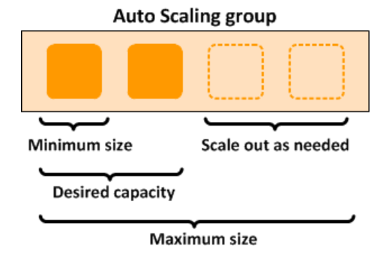
Auto Scaling:
Unlimited Powerful Learning
Amazon EC2 Auto Scaling helps you ensure that you have the correct number of Amazon EC2 instances available to handle the load for your application.
You can specify the minimum number of instances in each Auto Scaling group, and Amazon EC2 Auto Scaling ensures that your group never goes below this size.
You can specify the maximum number of instances in each Auto Scaling group, and Amazon EC2 Auto Scaling ensures that your group never goes above this size.

Slide 14
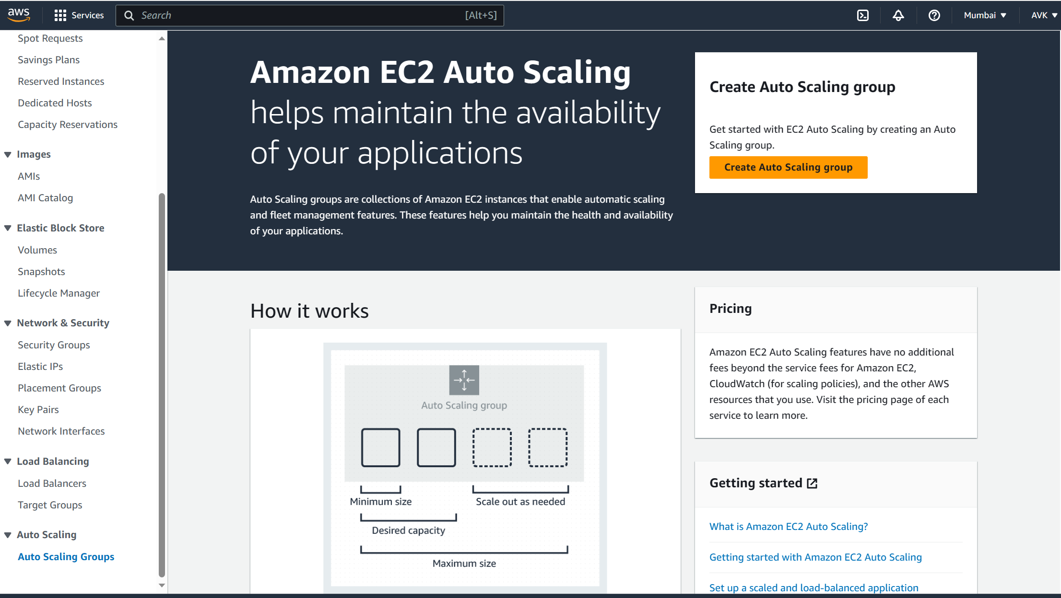
Launching Auto Scaling Group
Unlimited Powerful Learning
Step1:
From Auto scaling tab click on Auto Scaling group button.
Now Click on Create Auto Scaling group button.

Slide 15
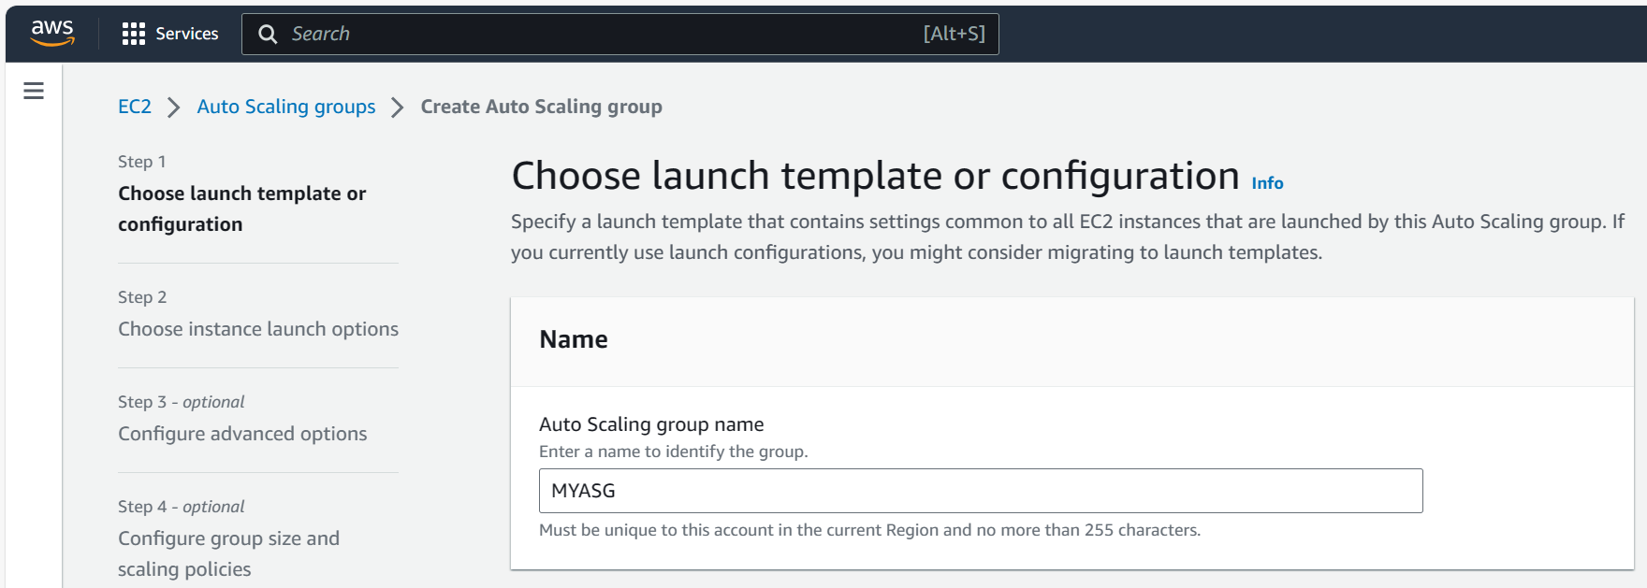
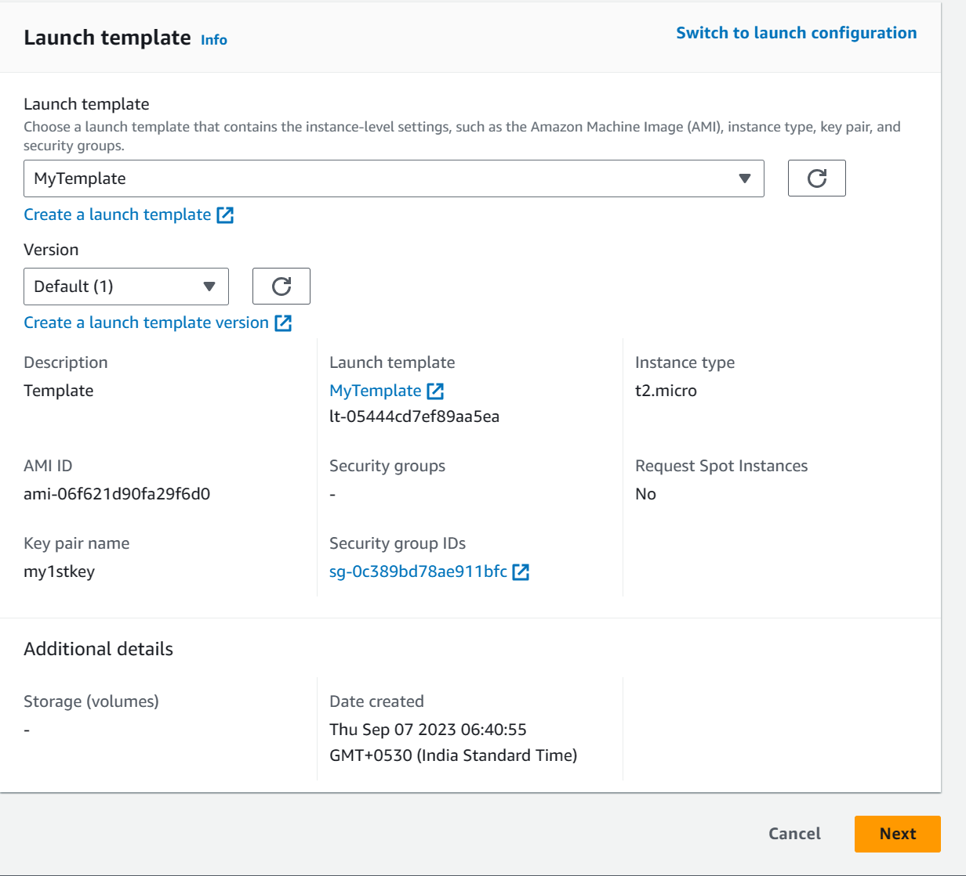
Unlimited Powerful Learning
Step2 :
In Auto Scaling group name tab enter a name to identify the group.
From Launch template option choose your launch template that contain the instance level settings such as AMI, instance type, key pair and security groups.
Click on Next button.

Slide 16
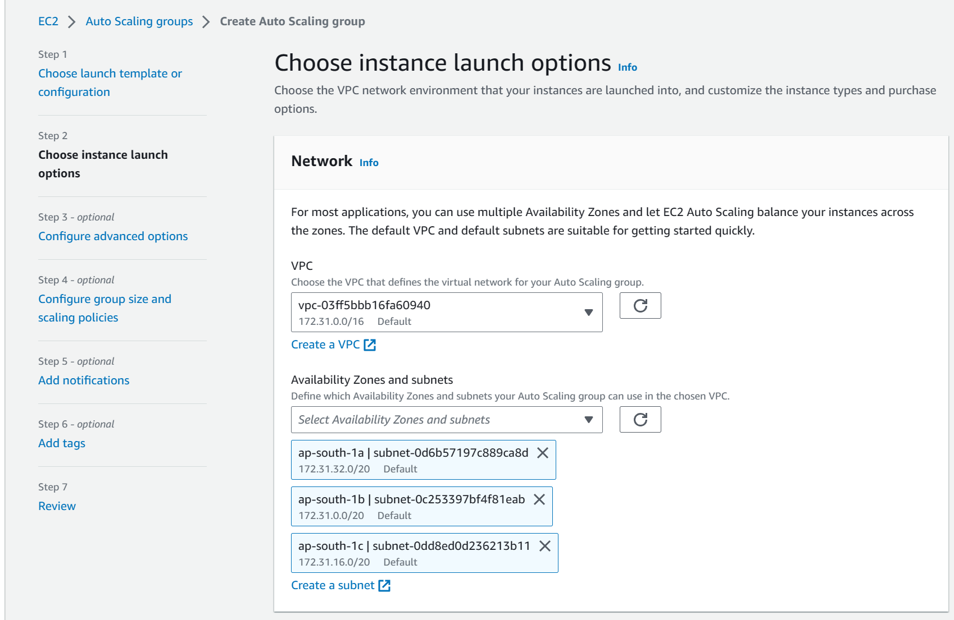
Unlimited Powerful Learning
Step3 :
From Choose instance launch options, choose VPC that defines the virtual network for Auto scaling group.
Select all three Availability zones from drop down for Availability Zones and subnets tab.
Click on Next button.

Slide 17
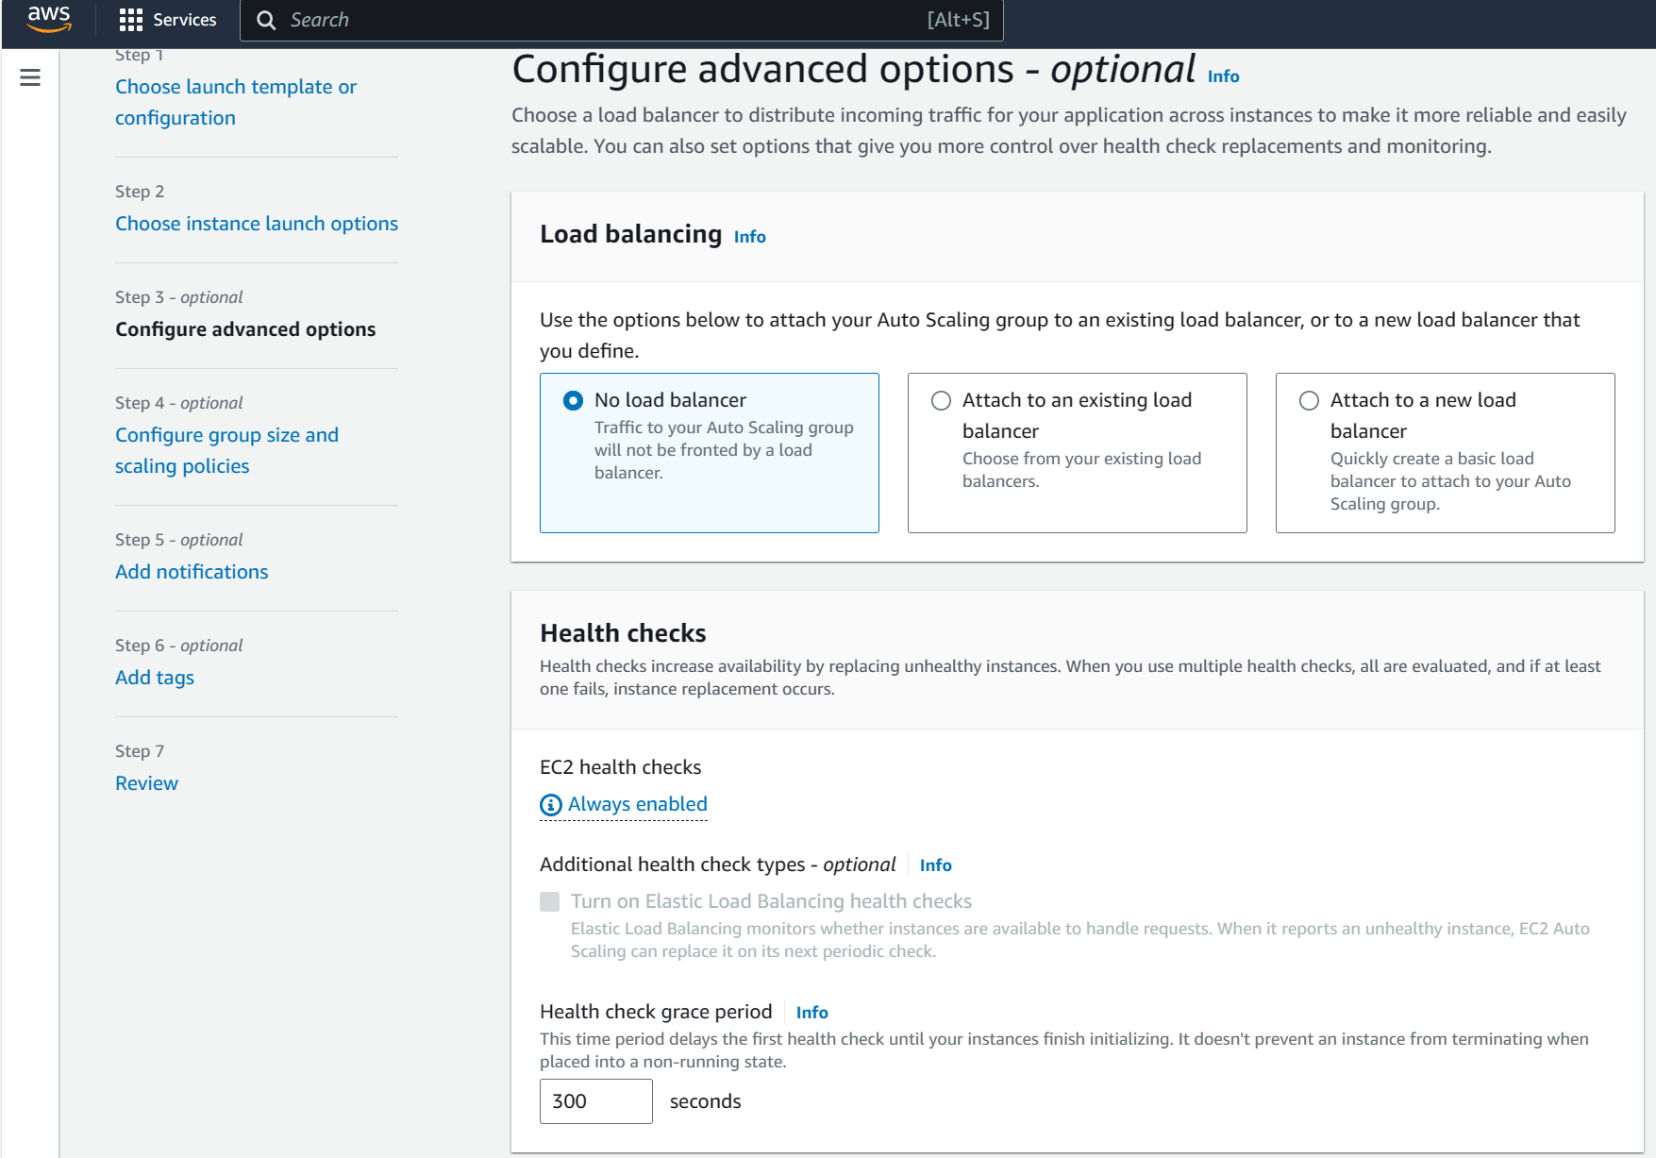
Unlimited Powerful Learning
Step4 :
From Configure advanced options tab, select default setting for Load balancing as No load balancer.
For Health checks tab, select default Health check grace period value as 300 seconds.
Click on Next button.

Slide 18
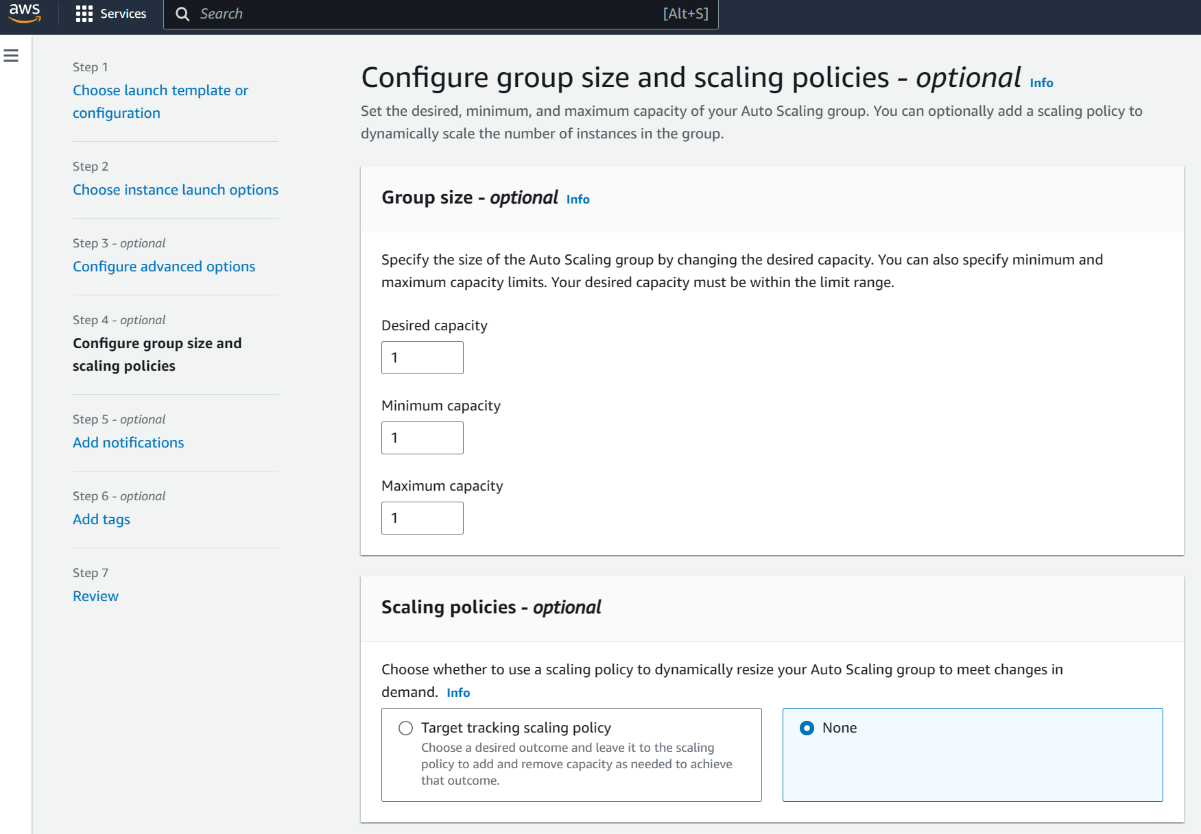
Unlimited Powerful Learning
Step5 :
In Group size option we will select Desired capacity as 1 Minimum Capacity as 1 and Maximum capacity as 1.
In Scaling policies choose as None.
Click on Next button.

Slide 19
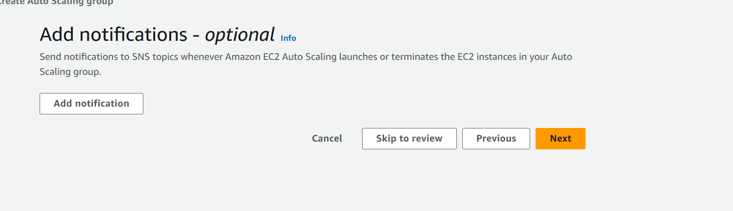
Unlimited Powerful Learning
Step6 :
In Add notifications option select as default and click on Next button.

Slide 20
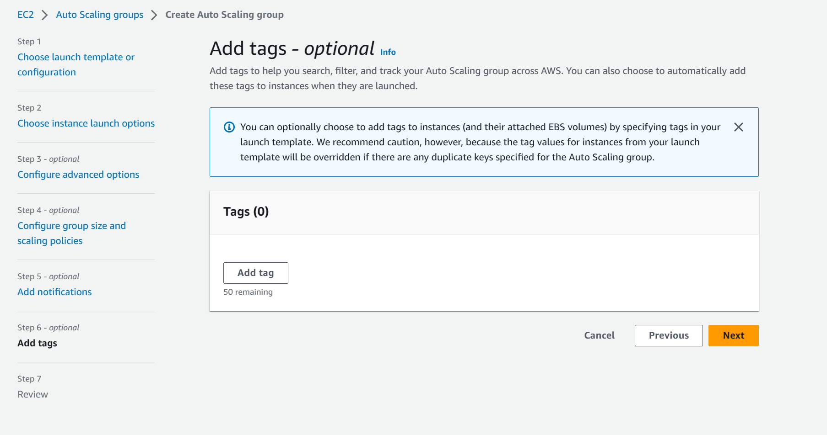
Unlimited Powerful Learning
Step7 :
Add tags option we will select as deault and click on Next button.

Slide 21
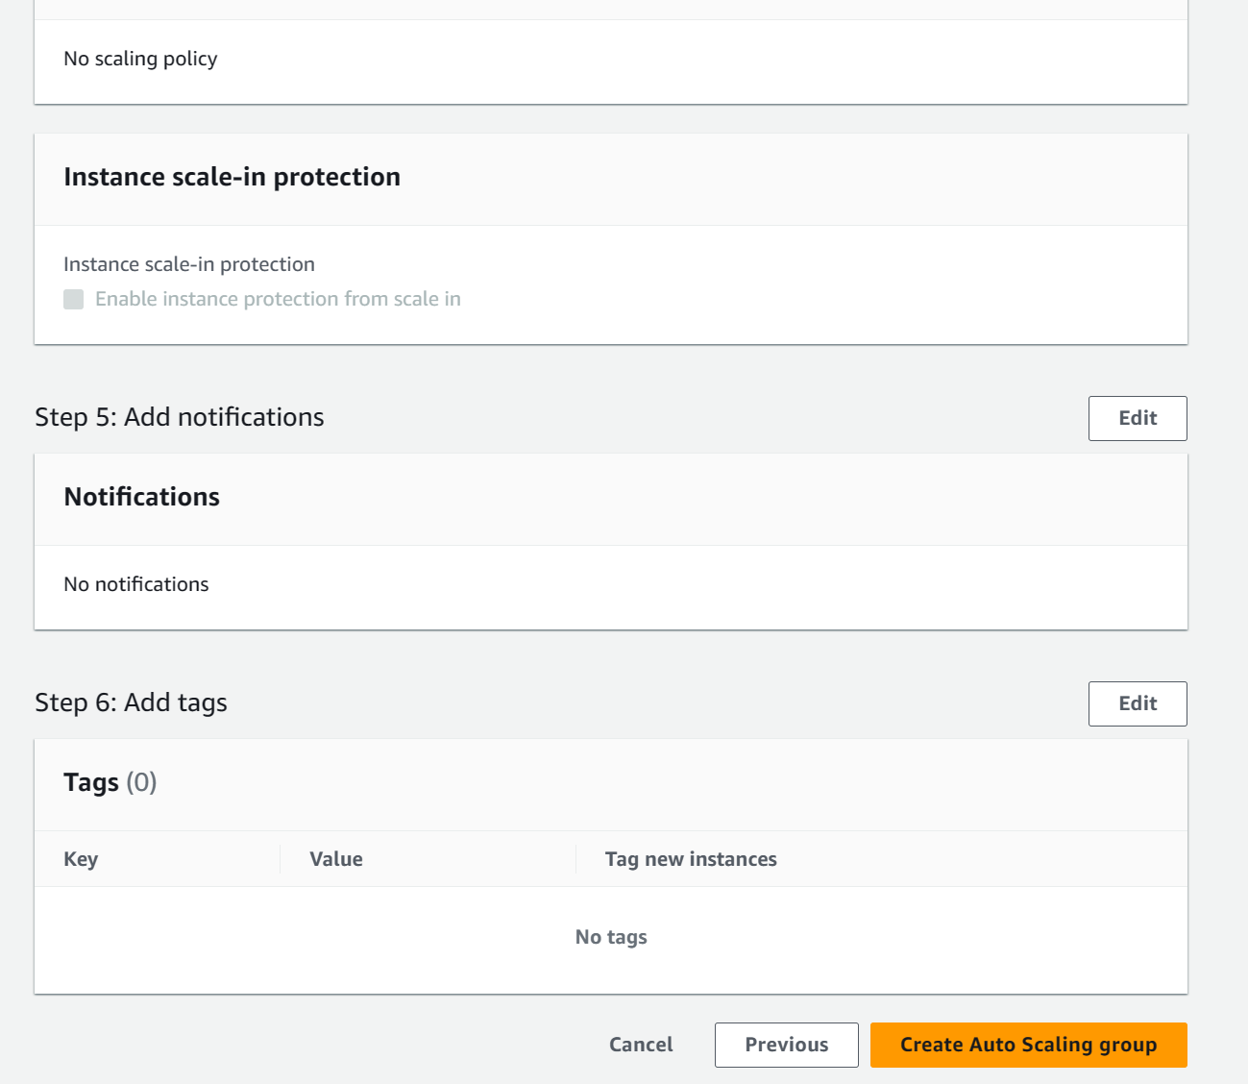
Unlimited Powerful Learning
Step8 :
Review all the settings once and click on Create Auto Scaling group tab.

Slide 22
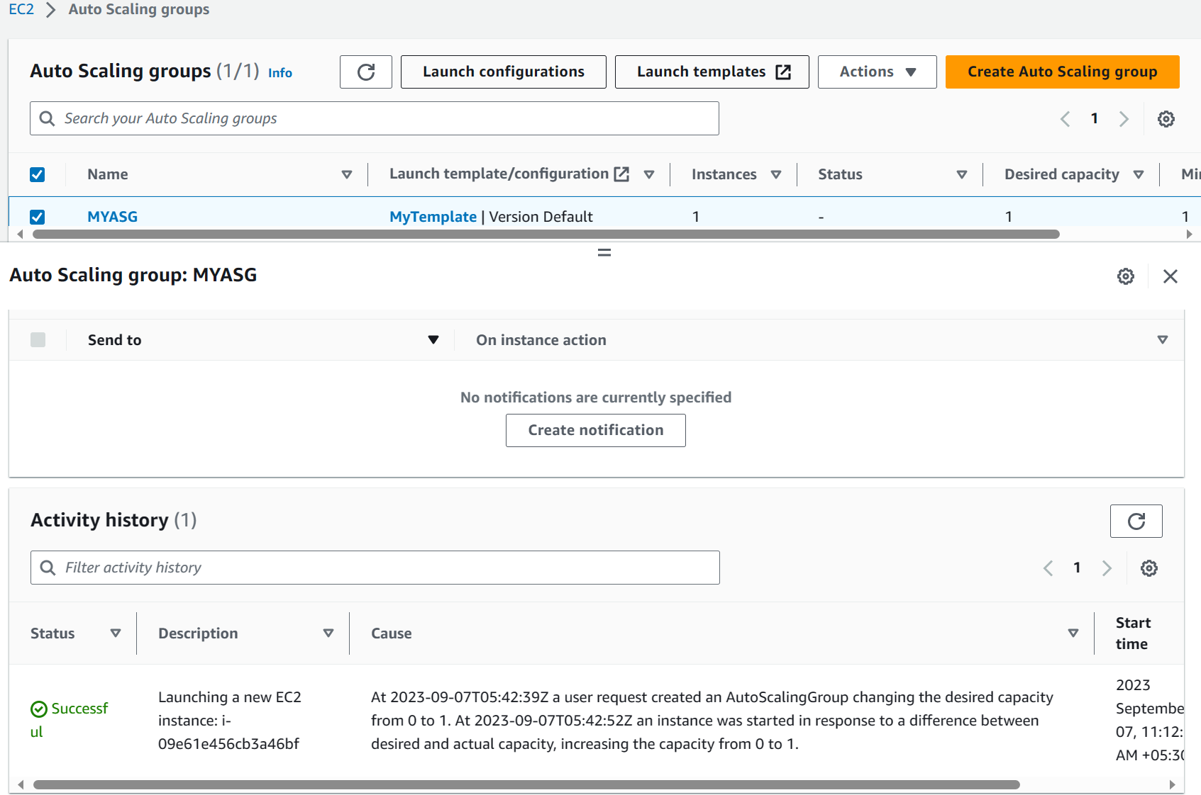
Unlimited Powerful Learning
Auto Scaling groups has successfully launched the template and also we can see in Activity history status showing as user request created an Auto scaling Group changing the desired capacity from 0 to 1 successfully.

Slide 23
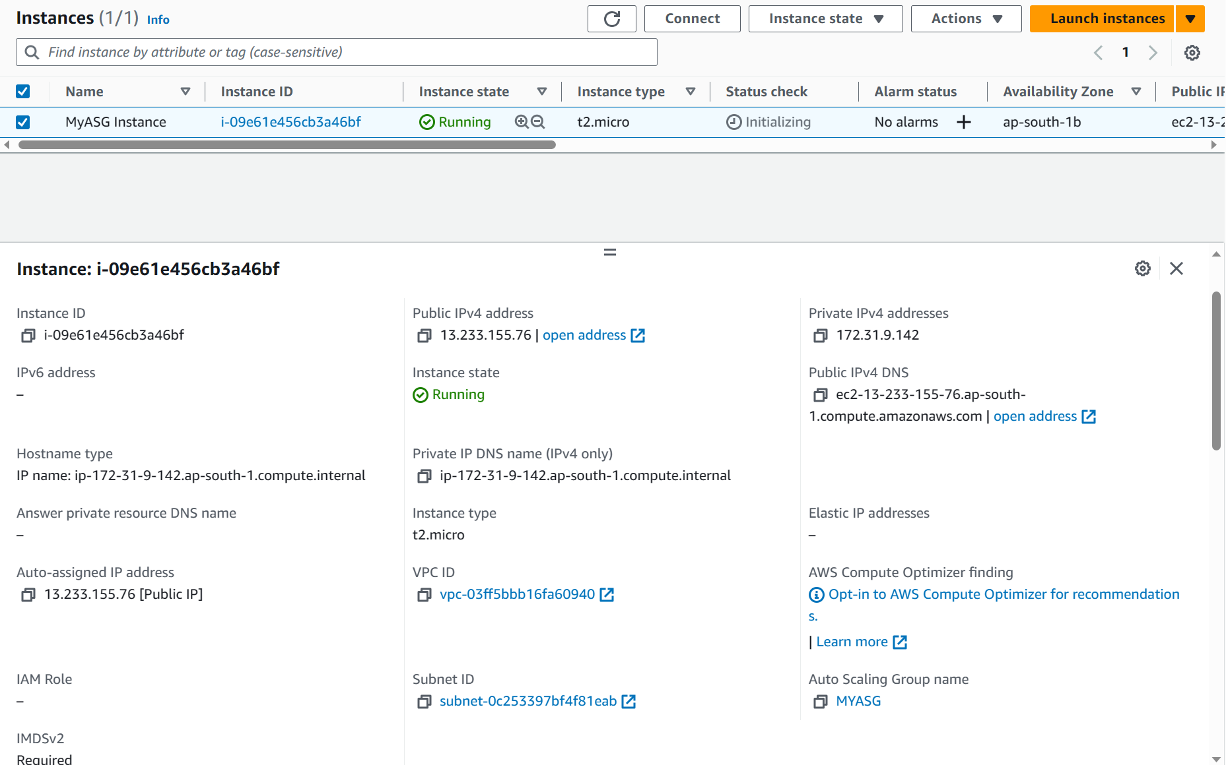
Unlimited Powerful Learning
When we click on EC2 instance tab we can notice one EC2 instance is running named as MYASG instance.

Slide 24
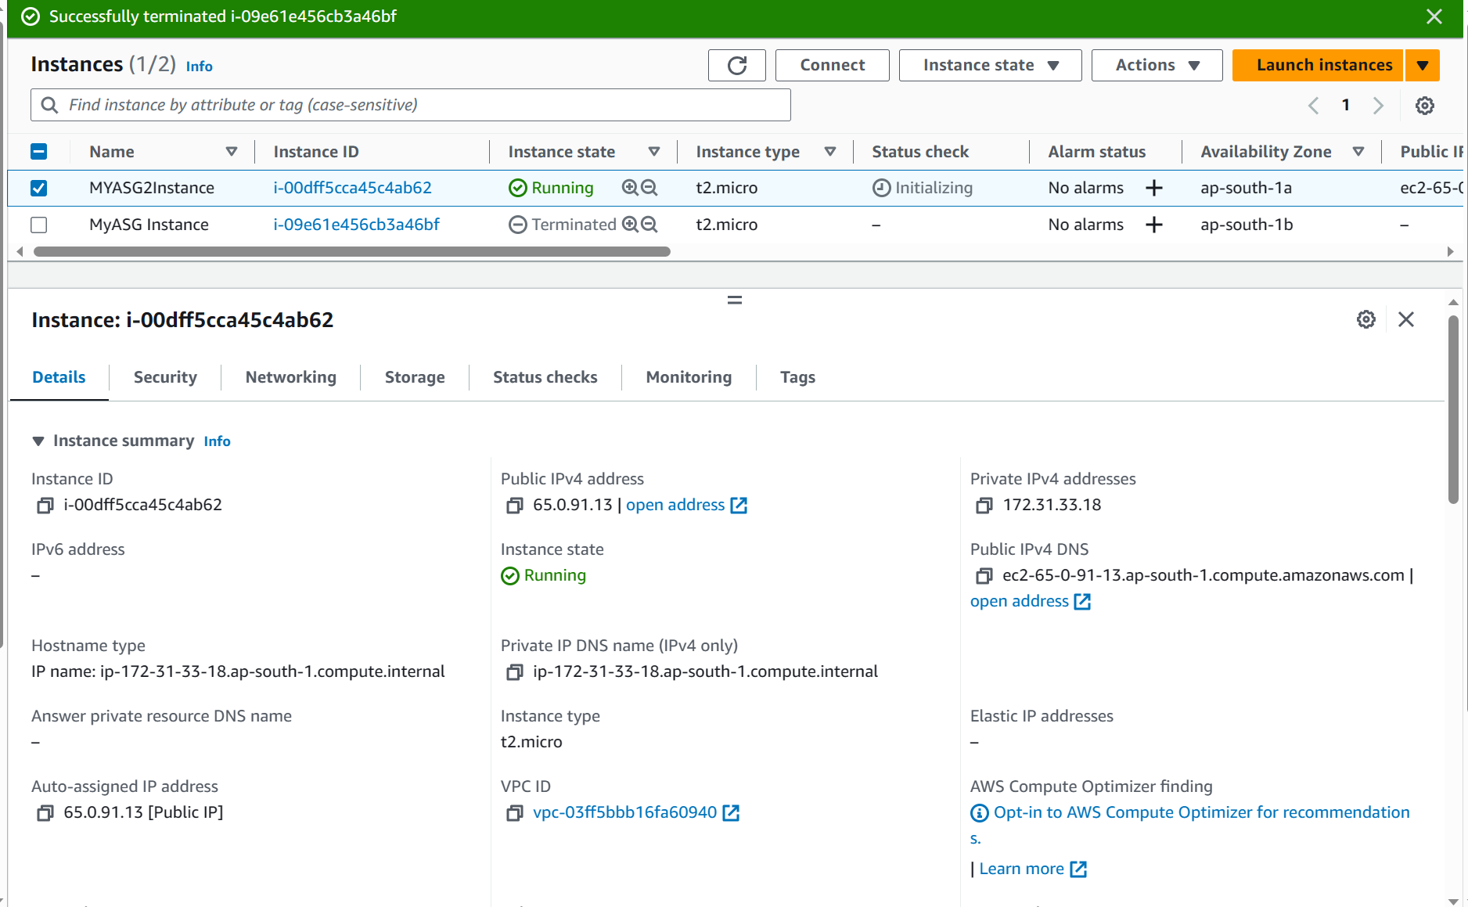
Unlimited Powerful Learning
Auto Scaling Functionality check - Demo
To check auto scaling functionality we will terminate our running EC2 instance.
We can see the terminated instance in Row 2 and automatically a new instance with the default parameters will be created as seen on Row 1.
This means that there is always at least one instance will be in running status.

Slide 25
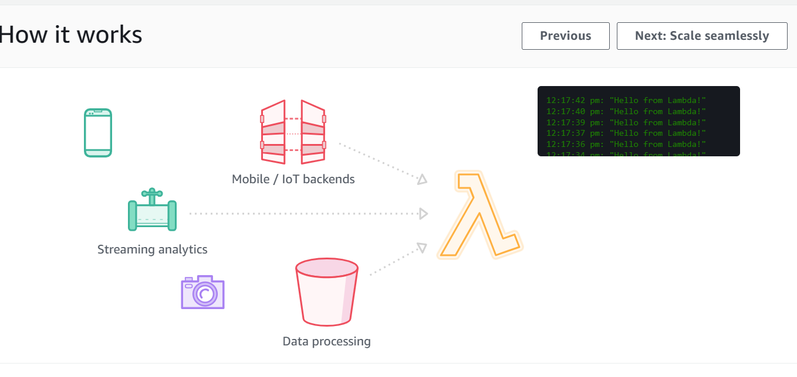
AWS Lambda
Unlimited Powerful Learning
AWS Lambda is a compute service that lets you run code without provisioning or managing servers.
Lambda runs your code on a high-availability compute infrastructure and performs all of the administration of the compute resources, including server and operating system maintenance, capacity provisioning and automatic scaling, and logging.
With Lambda, all you need to do is supply your code in one of the language runtimes that Lambda supports.
The Lambda service runs your function only when needed and scales automatically. You only pay for the compute time that you consume—there is no charge when your code is not running.

Slide 26
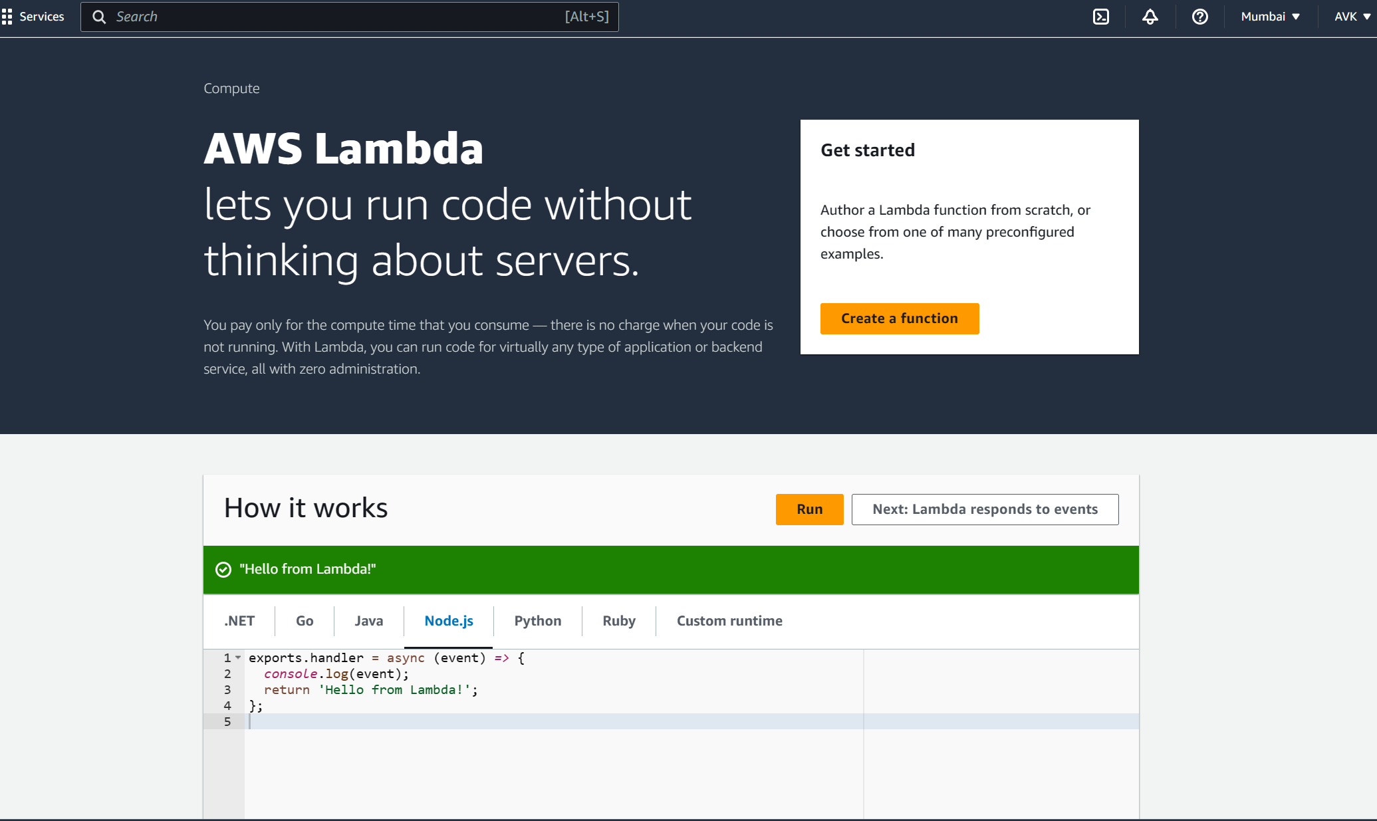
Deploying Lambda Function
Unlimited Powerful Learning
In AWS search for AWS Lambda service
In this page check for How it Works tab select a language as Node.js we can find a pre loaded program here click on Run button
As a result of this program we can get output as “Hello from Lambda!”
Now Click on Create a function tab.

Slide 27
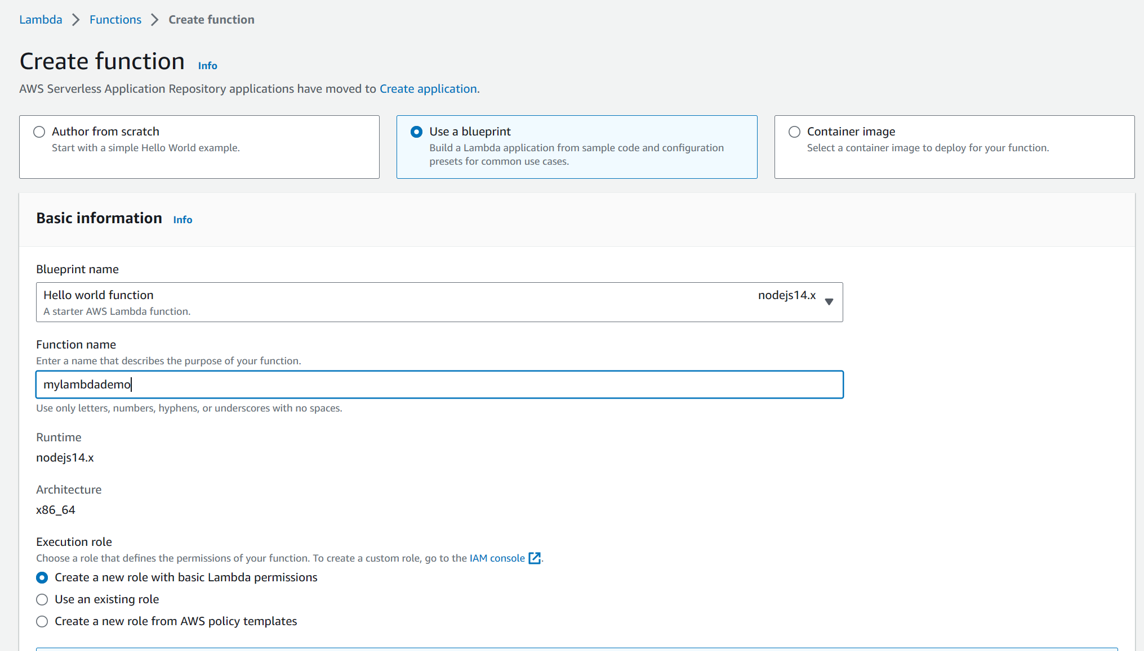
Unlimited Powerful Learning
Step1:
In Create function tab select Use a blueprint to build a Lambda application from sample code and configuration presets for common use cases.
Blueprint name select as default Hello world function nodejs.
In Function name tab enter a name that describe the purpose as mylambdademo.
In Execution role select as default Create a new role with basic Lambda permission.

Slide 28
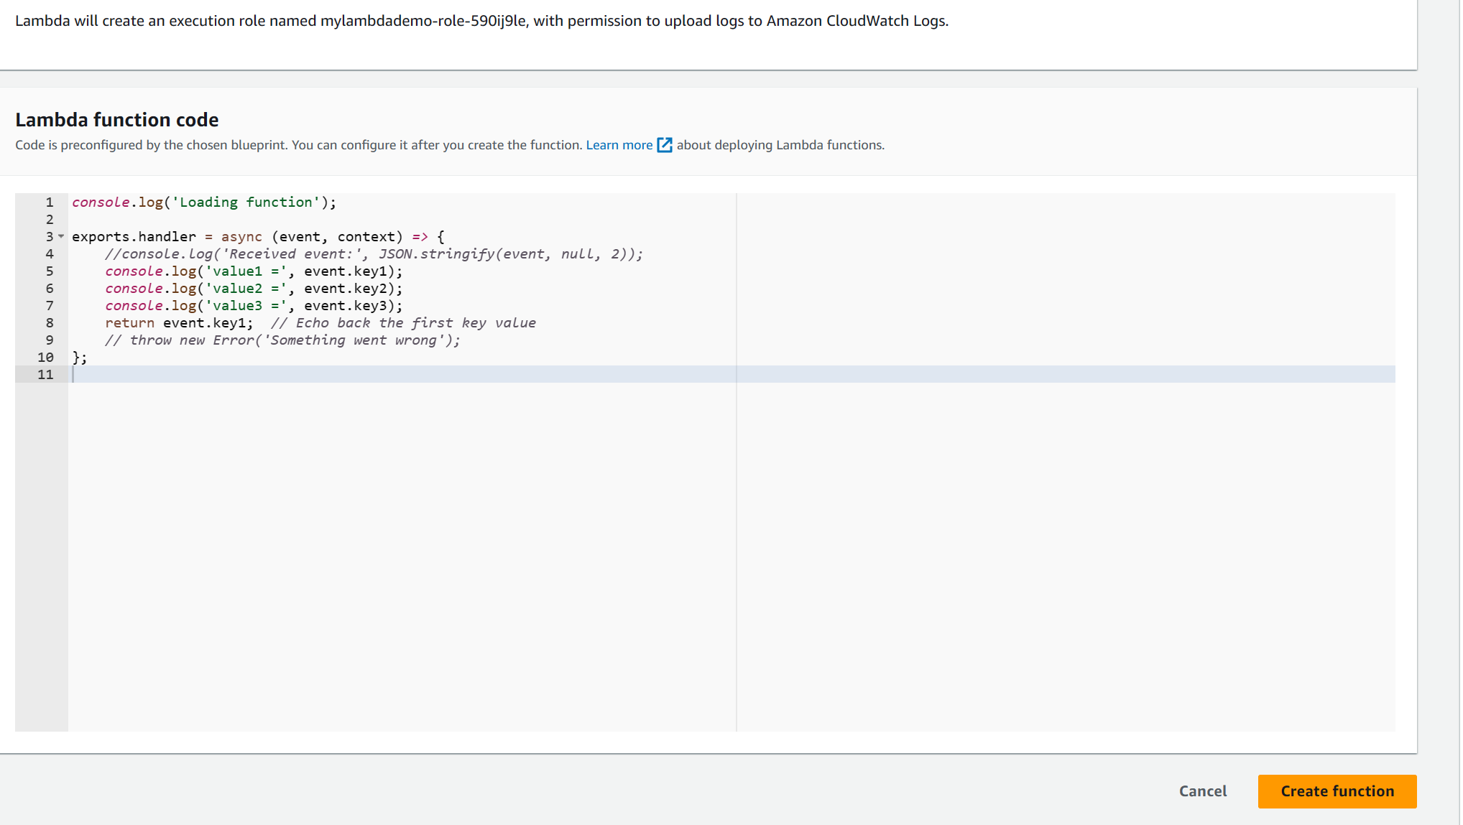
Unlimited Powerful Learning
Step2:
Once we scold down we can find preconfigured code as we have chosen blueprint option.
Click on Create Function tab.

Slide 29
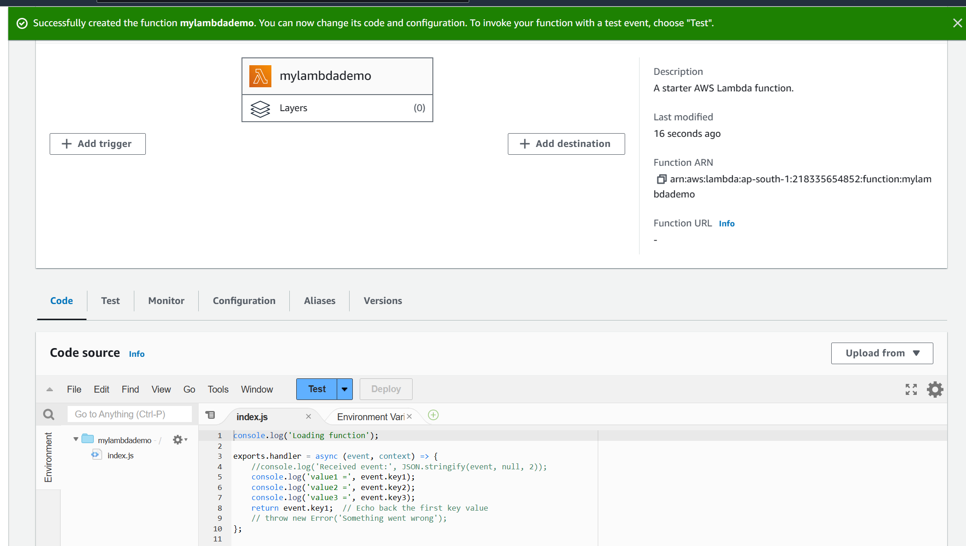
Unlimited Powerful Learning
As we can see we have successfully create the function mylambdademo.
In index.js tab we can see preconfigured nodejs code.
Now we click on Test button to configure a test event.

Slide 30
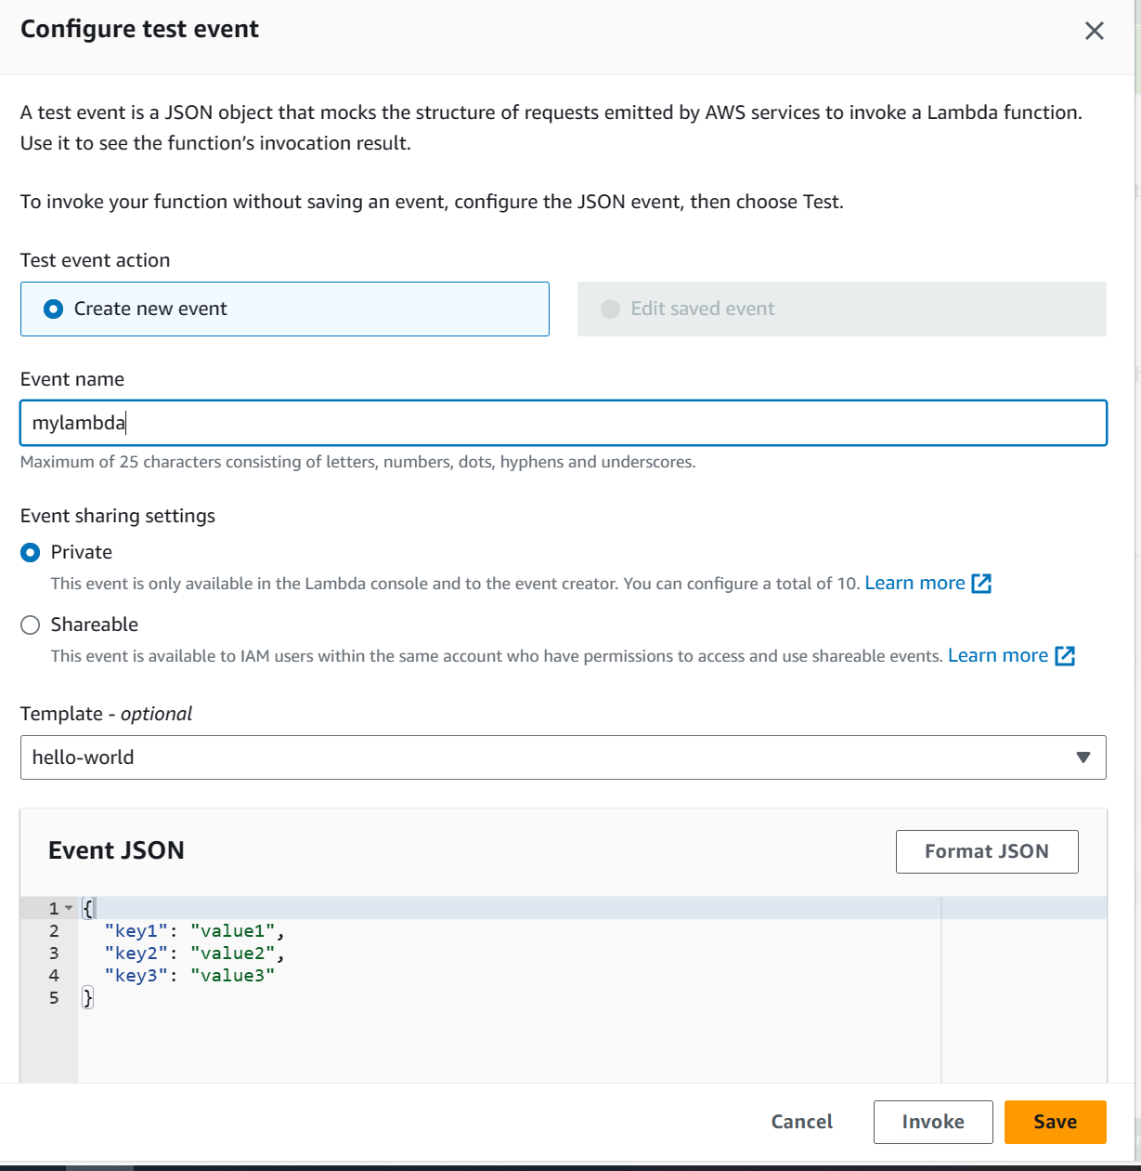
Unlimited Powerful Learning
Step3:
In test event action select as Create new event.
Type event name as mylambda
For Event sharing settings we will select default as Private.
Click on Save button.

Slide 31
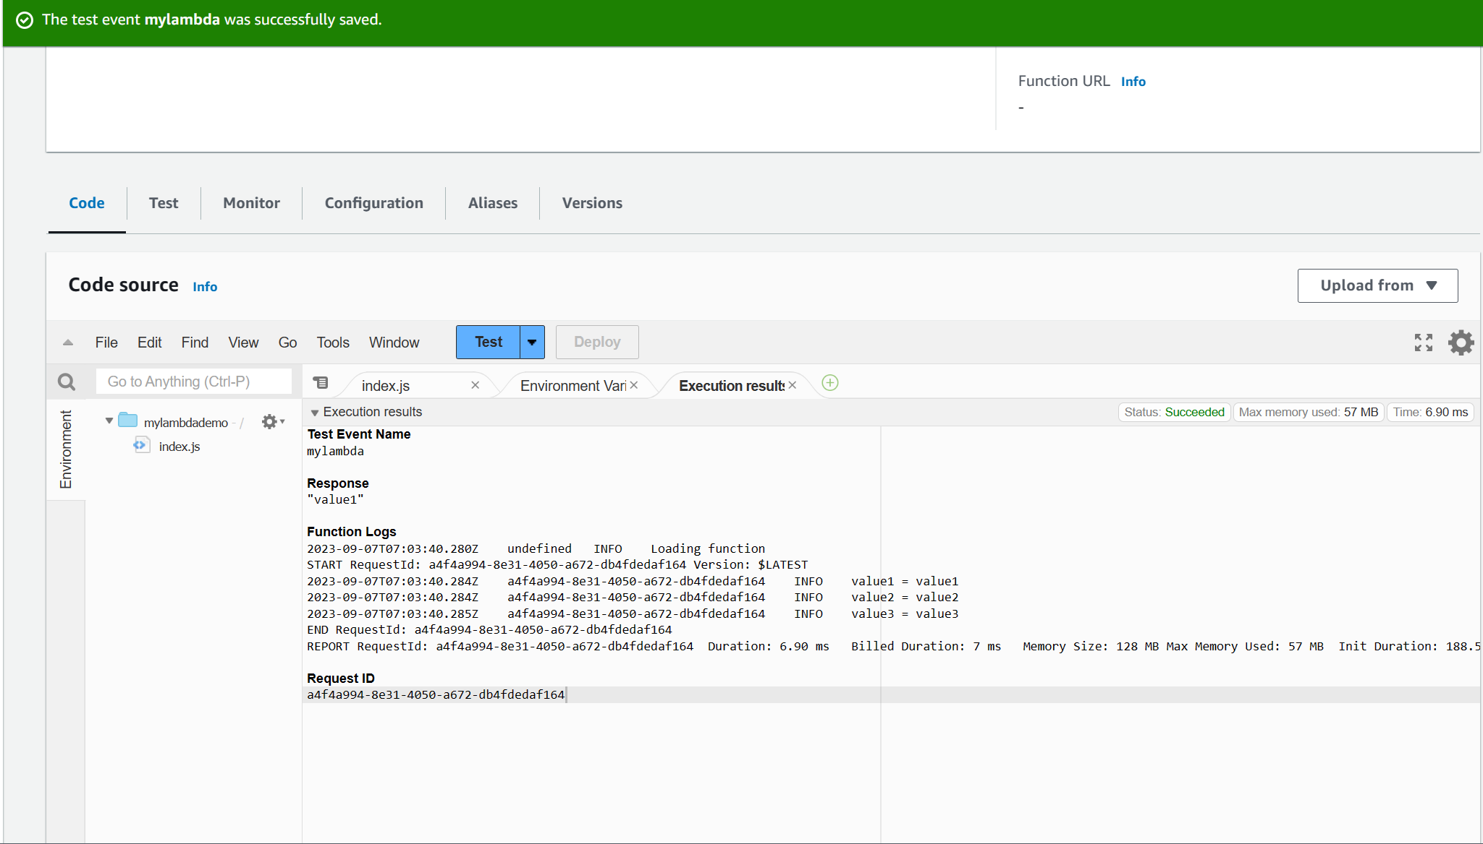
Unlimited Powerful Learning
Once the test event is successfully saved now we will click on Test button.
Execution result tab will show us output of our program as successful.

